Slide 1


AI Personal Productivity Agent
AMULATE HACKATHON 2025
Team Name: Team Forcus
Presenter Names: Ahmad Zakariya
Challenge: BMW - Develop an AI assistant that helps users plan their day or manage tasks by integrating reasoning with tools
December 30, 2025
1

Slide 2





Agenda
  The problem we are trying to solve and why it matters
  Our idea: U-Dot AI, an agentic productivity assistant
  How the productivity agent works (architecture & reasoning)
  Live demo: U-Dot AI in action
  Conclusion, impact, and future scopes
2
Notes:
2

Slide 3


Problem Statement and Motivation
What is the Problem and Why are we solving it?
Problem
Motivation
  Knowledge workers juggle multiple tasks and context switches daily
  Most productivity tools rely on static to-do lists
  Real-world constraints like time, effort, and priority are ignored
  Users must manually decide what to do next
  This leads to poor prioritization and overloaded schedules
  Productivity should be guided by reasoning, not just reminders
  Users should interact using natural language
  Planning must consider time, priorities, and constraints
  The system should act using tools, not just reply with text
  Goal: build a true agent, not another to-do app
3

Slide 4





Solution Overview
Key Features
Deterministic Scheduling with Constraints
Task scheduling is handled by deterministic logic, ensuring transparency and reliability in how time blocks are allocated.
Agentic Day Planning
U-Dot AI reasons about tasks, priorities, and available time to create a realistic daily plan instead of a static task list.
Natural Language Task & Preference Understanding
Users can interact naturally, and the agent extracts intent, effort, and constraints.
Stateful Memory Across Interactions
Users can interact naturally (e.g., “Add a 2-hour coding session after lunch”), and the agent extracts intent, effort, and constraints.
Self-Aware Agent Execution Flow
The agent explicitly goes through reasoning, execution, and completion states, reinforcing trust and explainability.
4

Slide 5
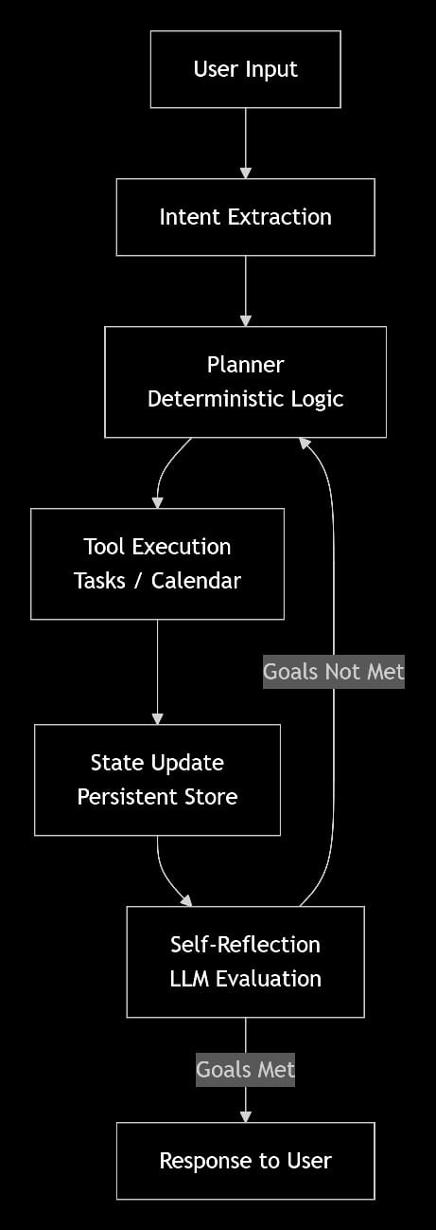
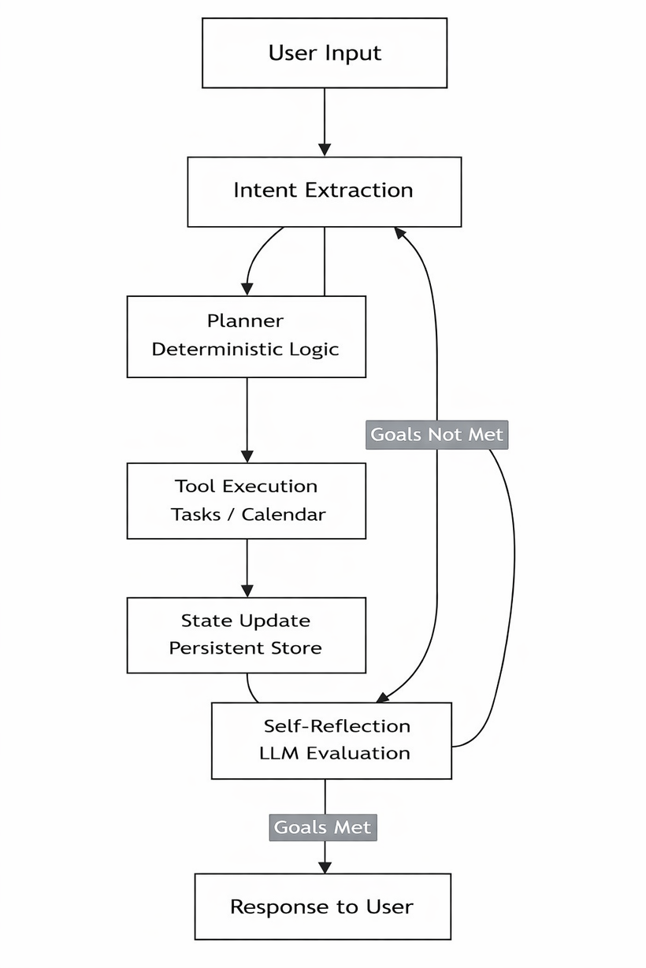
Solution Deep-Dive
Architecture
How the agent works behind the scenes:
User Interface (Web App)
Intent & Reasoning Layer (LLM)
Agent Orchestration (LangGraph)
Deterministic Tools & State
Scheduling, task updates, and constraint handling are implemented using deterministic Python logic to ensure transparency and reliability.
  Persistent Agent State
  The agent maintains:
  Tasks and priorities
  Calendar events
  User preferences
  Last action summary
  User interacts with U-Dot AI using natural language
  Simple web-based interface
A Large Language Model is used strictly for:
  Intent extraction
  Effort and constraint understanding
  Summarization and reflection
  The LLM does not directly modify state.
The agent follows an explicit reasoning loop with well-defined states:
  Parse intent
  Plan actions
  Execute tools
  Update state
  Self-reflect
  Respond to user
5

Slide 6
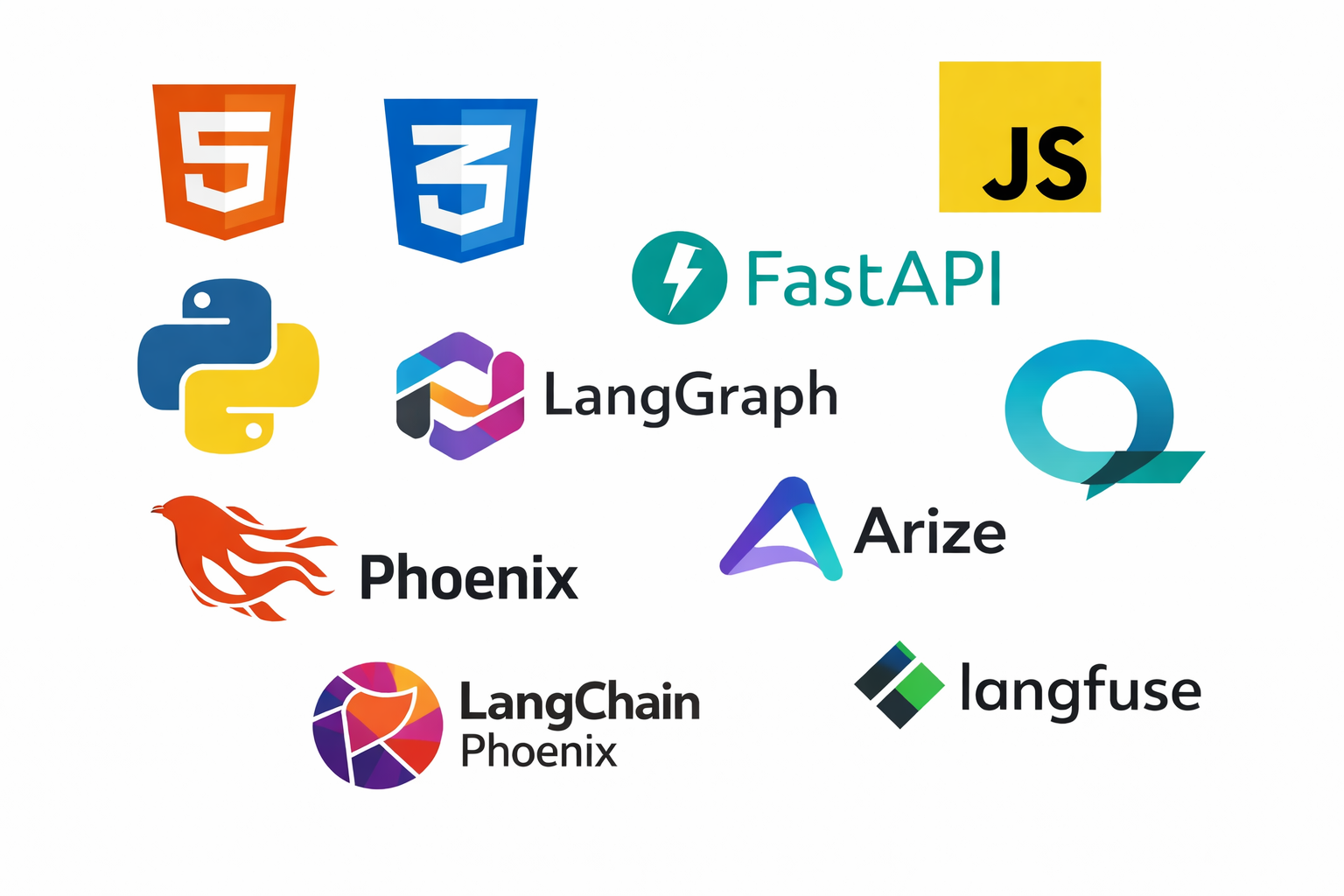



Solution Deep-Dive
Implementation Details
Agent Logic
Tools Used
  State-driven agent
    Maintains tasks, calendar events, preferences, and history
  Explicit reasoning loop (LangGraph)
    Parse intent
    Plan actions
    Execute tools
    Update state
    Self-reflect
    Respond to user
  Clear LLM boundaries
    LLM used only for understanding and reasoning
    All scheduling logic remains deterministic
  Self-reflection step
    Verifies execution success before responding
  Frontend: HTML, CSS, JavaScript (custom UI for agent interaction)
  Backend: Python, FastAPI
  Agent Framework: LangGraph (explicit agent state transitions)
  LLM Provider:Google Vertex AI (Gemini models)
  State & Scheduling: Deterministic Python logic (task prioritization, time blocking)
  Observability (Planned): Arize Phoenix / Langfuse for tracing reasoning and tool usag
6

Slide 7

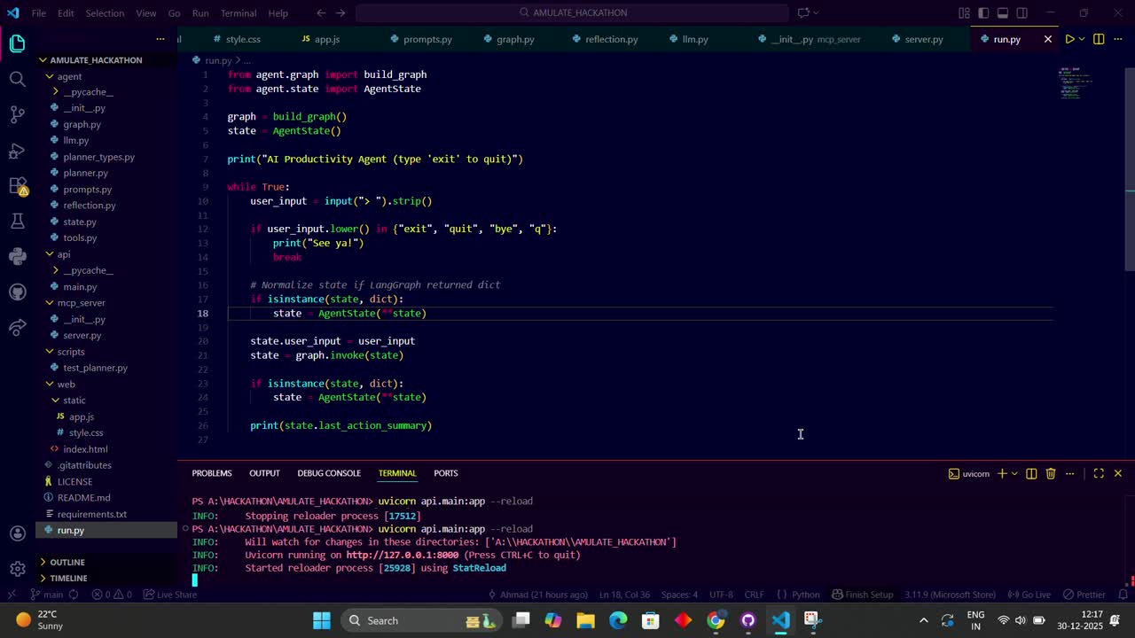
Demo
Video Demo
Watch the agent plan a real day in seconds
7

Slide 8
Conclusions and Future Evolutions
Conclusion
Future Scopes
  We built U-Dot AI, a true agentic productivity assistant that goes beyond task listing to reason, plan, and act
  The system combines:
    Natural language understanding
    Deterministic scheduling logic
    Explicit agent reasoning loops
  By separating reasoning from execution, ARCUES AI is:
    Transparent
    Predictable
    Trustworthy
  The project demonstrates how modern AI systems can be designed as agents, not chatbots
  Calendar Integration : Integrate with real calendar APIs (e.g., Google Calendar) for live scheduling and updates
  Advanced Self-Reflection & Feedback : Enhance the agent’s ability to explain decisions and learn from user feedback
  Observability & Monitoring : Add full tracing using tools like Arize Phoenix or Langfuse for reasoning transparency
  User Support : Extend U-Dot AI to support different user personas such as product managers or team leads
  Long-Term Memory & Optimization : Enable the agent to learn productivity patterns and optimize plans over time
8

